Slide 1
Voltage Regulators
By: Bryan Rhoton

Slide 2
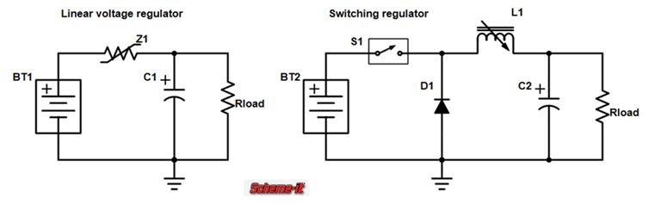
Intro
Voltage Regulators, also known as voltage converters, are a group of electronic components designed to provide a constant voltage output with a varying voltage input.
There are two main types of these regulators: switching and linear.
The main difference between the two types is the difference in the efficiencies in their outputs [1].
Figure 1. Linear and Switching Regulator Circuits
Source: adapted from [2]

Slide 3

Types
There are several different types of switching regulators including:
Step-up regulators
Step-down regulators
Inverting regulators
Step-up / Step-down regulators
Figure 2. Buck-boost Converter
Source: Adapted from [3]

Slide 4
What They Do
Switching regulators are used to convert only dc voltages specifically, they are also regularly referred to as dc-to-dc converters.
Step up/down regulators, also called buck/boost converters, specifically are used to convert input voltages to either higher or lower voltages depending on the desired output.

Slide 5
How They Work (1)
Buck-boost converters use two separate modes to control if the converter is “bucking” or “boosting”.
While in “buck” mode the converter will produce a lower voltage than the input and while in “boost” mode it will produce a higher voltage.
They usually operate by using a transistor as a switch connected to a diode to control current flow through an inductor and a capacitor with energy being stored with the inductor in the “on” state and dispersed to the output via the diode in the “off” state.
The converter’s output voltage is controlled via the switch’s duty cycle which allows the converter to maintain a desired voltage level for prolonged periods [3].

Slide 6
How They Work (2)
When the switch is set in the “on” position the input voltage is connected directly to the inductor causing its current to rise in a linear fashion until reaching its maximum value.
When in the “off” position, the inductor current is passed through the diode to supply the desired voltage to the load over time the current inside the inductor is reduced to its minimum value resetting the cycle.
While in the resting state there is no voltage across the inductor [3].

Slide 7
Voltage Supply Calculations
The following are some examples of calculations for the supplied voltages:
Positive switch voltage = power supply voltage x time on
Negative switch voltage = load voltage x time off

Slide 8
Regulator Modes
Buck-boost converters have two distinct modes that they operate in indicated by the behavior of the inductor’s current during the switching cycle:
Continuous Conduction Mode or CCM, current never reaches zero and is always positive.
Advantages: Better responsiveness and efficiency
Disadvantages: Larger inductor values
Discontinuous Conduction Mod or DCM, current periodically reaches zero.
Advantages: Smaller inductor values and more compact design
Disadvantages: Bigger output ripple and less efficiency
Some converters operate in both modes switching between the two when necessary [3].

Slide 9
Mode Uses
CCM is frequently used in large power applications due to its highly reliable output and responsiveness.
CCM is also used when output voltage needs to remain relatively constant and cannot be widely varied.
DCM is typically used in low power applications and situations with extremely low load current due to its lower efficiency and higher output ripple voltage [3].

Slide 10
Design Process (1)
When designing a buck-boost converter one must consider several factors including:
Selection of components
Strategy by which to control components
Calculations for required parameters
Capacitor capacitances
Component considerations:
Appropriate voltage and current ratings for switches
Low forward voltage drop and quick recovery time for diodes
Maintainability of chosen conduction mode for inductors
Low series resistance and high capacitance for capacitors [3]

Slide 11
Design Process (2)
Control strategy considerations:
Desired output voltage, usually managed with pulse-width modulation (PWM)
Circuit stability
Parameter considerations:
Duty cycle, to control output voltage
Inductance, to determine conduction mode ripple of output voltage [3]

Slide 12
Typical Essential Components
Buck-boost converters usually consist of the following components:
A switch, or switching device, which is usually a transistor chosen to regulate the inductor’s current flow and to determine the converters modes of operation and voltage output.
A diode to direct current from the inductor to the load and to prevent the capacitor from outputting voltage to the input.
An inductor to store energy and disperse it to the load depending on the switch’s “on/off” cycle.
A capacitor to provide a smooth and stable output voltage.
And finally input and output filters to reduce interference and “noise” from outside sources [3].

Slide 13
Design Parameter Equations
Duty Cycle = Output Voltage / (Input Voltage + Output Voltage)
Output Voltage = Input Voltage x (Time On / Time Off)
Inductor Value = (Input Voltage x Duty Cycle) / (Change in Inductor Current over Time x Switch Frequency)

Slide 14
Regulator Efficiency and Circuit Losses (1)
The overall efficiency of a buck-boost converter circuit is dependent on several factors including:
Losses in conduction
Efficiency of the switch
Losses due to magnetic energy
Control circuitry based losses
Losses in circuit conduction causes:
Individual component’s natural resistances
Current through the switch and its “on” mode resistance
Current through the diode and its forward voltage drop [3]

Slide 15
Regulator Efficiency and Circuit Losses (2)
Switching efficiency is affected by the time it takes for the chosen device to switch from its “on” state into its “off” state and vice versa.
Magnetic energy loss causes:
Inductor core material
Wire winding method
The chosen wiring and circuitry for the converter’s controls cause minimal losses within power efficiency but are still considered when calculating the overall converter efficiency [3].

Slide 16
Advantages
Energy efficient
Fewer external components
Smaller components
Availability of both step-up and step-down voltages
Cost efficient [4]

Slide 17

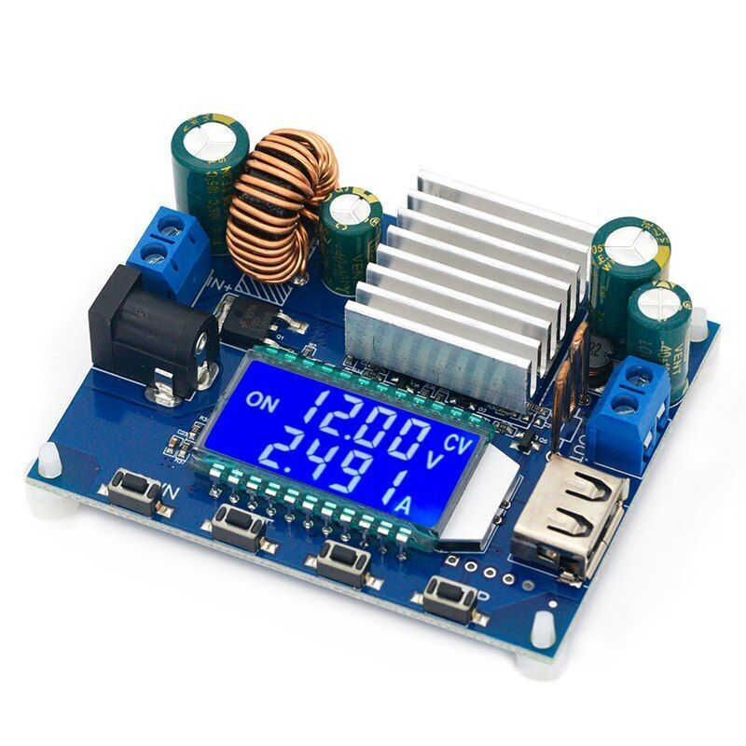
Disadvantages
High gains not possible
No input/output isolation [4]
Figure 4. Buck-boost Converter Example
Source: Adapted from [5]

Slide 18
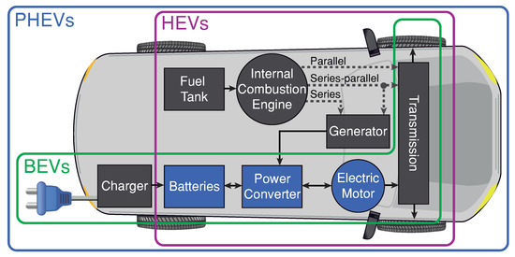
Uses
Portable and handheld devices
Energy collection and storage systems
Vehicles
Industrial and communication technology
Lighting [3]
Figure 5. Converter Inside Electric Vehicle
Source: Adapted from [6]

Slide 19
References
[1] Monolithic Power Systems. “Voltage Regulator Types and Working Principles”. (2024). Accessed: Mar. 20, 2024. [online]. Available: https://www.monolithicpower.com/en/voltage-regulator-types#:~:text=There%20are%20two%20main%20types,regulators%20operate%20with%20high%20efficiency.
[2] DigiKey. “Linear Voltage Regulator vs. Switching Regulator”. (Nov. 2017). Accessed: Mar. 21, 2024. [online]. Available: https://forum.digikey.com/t/linear-voltage-regulator-vs-switching-regulator/817
[3] Monolithic Power Systems. “Buck-Boost Converters”. (2024). Accessed: Mar. 20, 2024. [online]. Available: https://www.monolithicpower.com/en/power-electronics/dc-dc-converters/buck-boost-converters#:~:text=The%20buck-boost%20converter%20operates%20using%20a%20switch%2C%20typically%20a,the%20output%20through%20the%20diode.
[4] L. James, “Advantages of buck-boost converters”. Power & Beyond. Accessed: Mar. 20, 2024. [online]. Available: https://www.power-and-beyond.com/advantages-of-buck-boost-converters-a-f75372c245154eb05a436628cb0a8faa/#:~:text=Buck-boost%20converters%20are%20also,–%20no%20in-between).
[5] Ebay. Accessed: Mar. 21, 2024. [online]. Available: https://www.ebay.com/itm/225508000268
[6] C. Gonzalez-Castano, C. Restrepo, S. Kouro, E. Vidal-Idiarte, J. Calvente, “A Bidirectional Versatile Buck-Boost Converter Driver for Electric Vehicle Applications,” Sensors, vol. 21, no. 17, Aug. 2024. Accessed: Mar. 21, 2024. doi: 10.3390/s21175712. [online]. Available: https://www.mdpi.com/1424-8220/21/17/5712.

